Slide 1
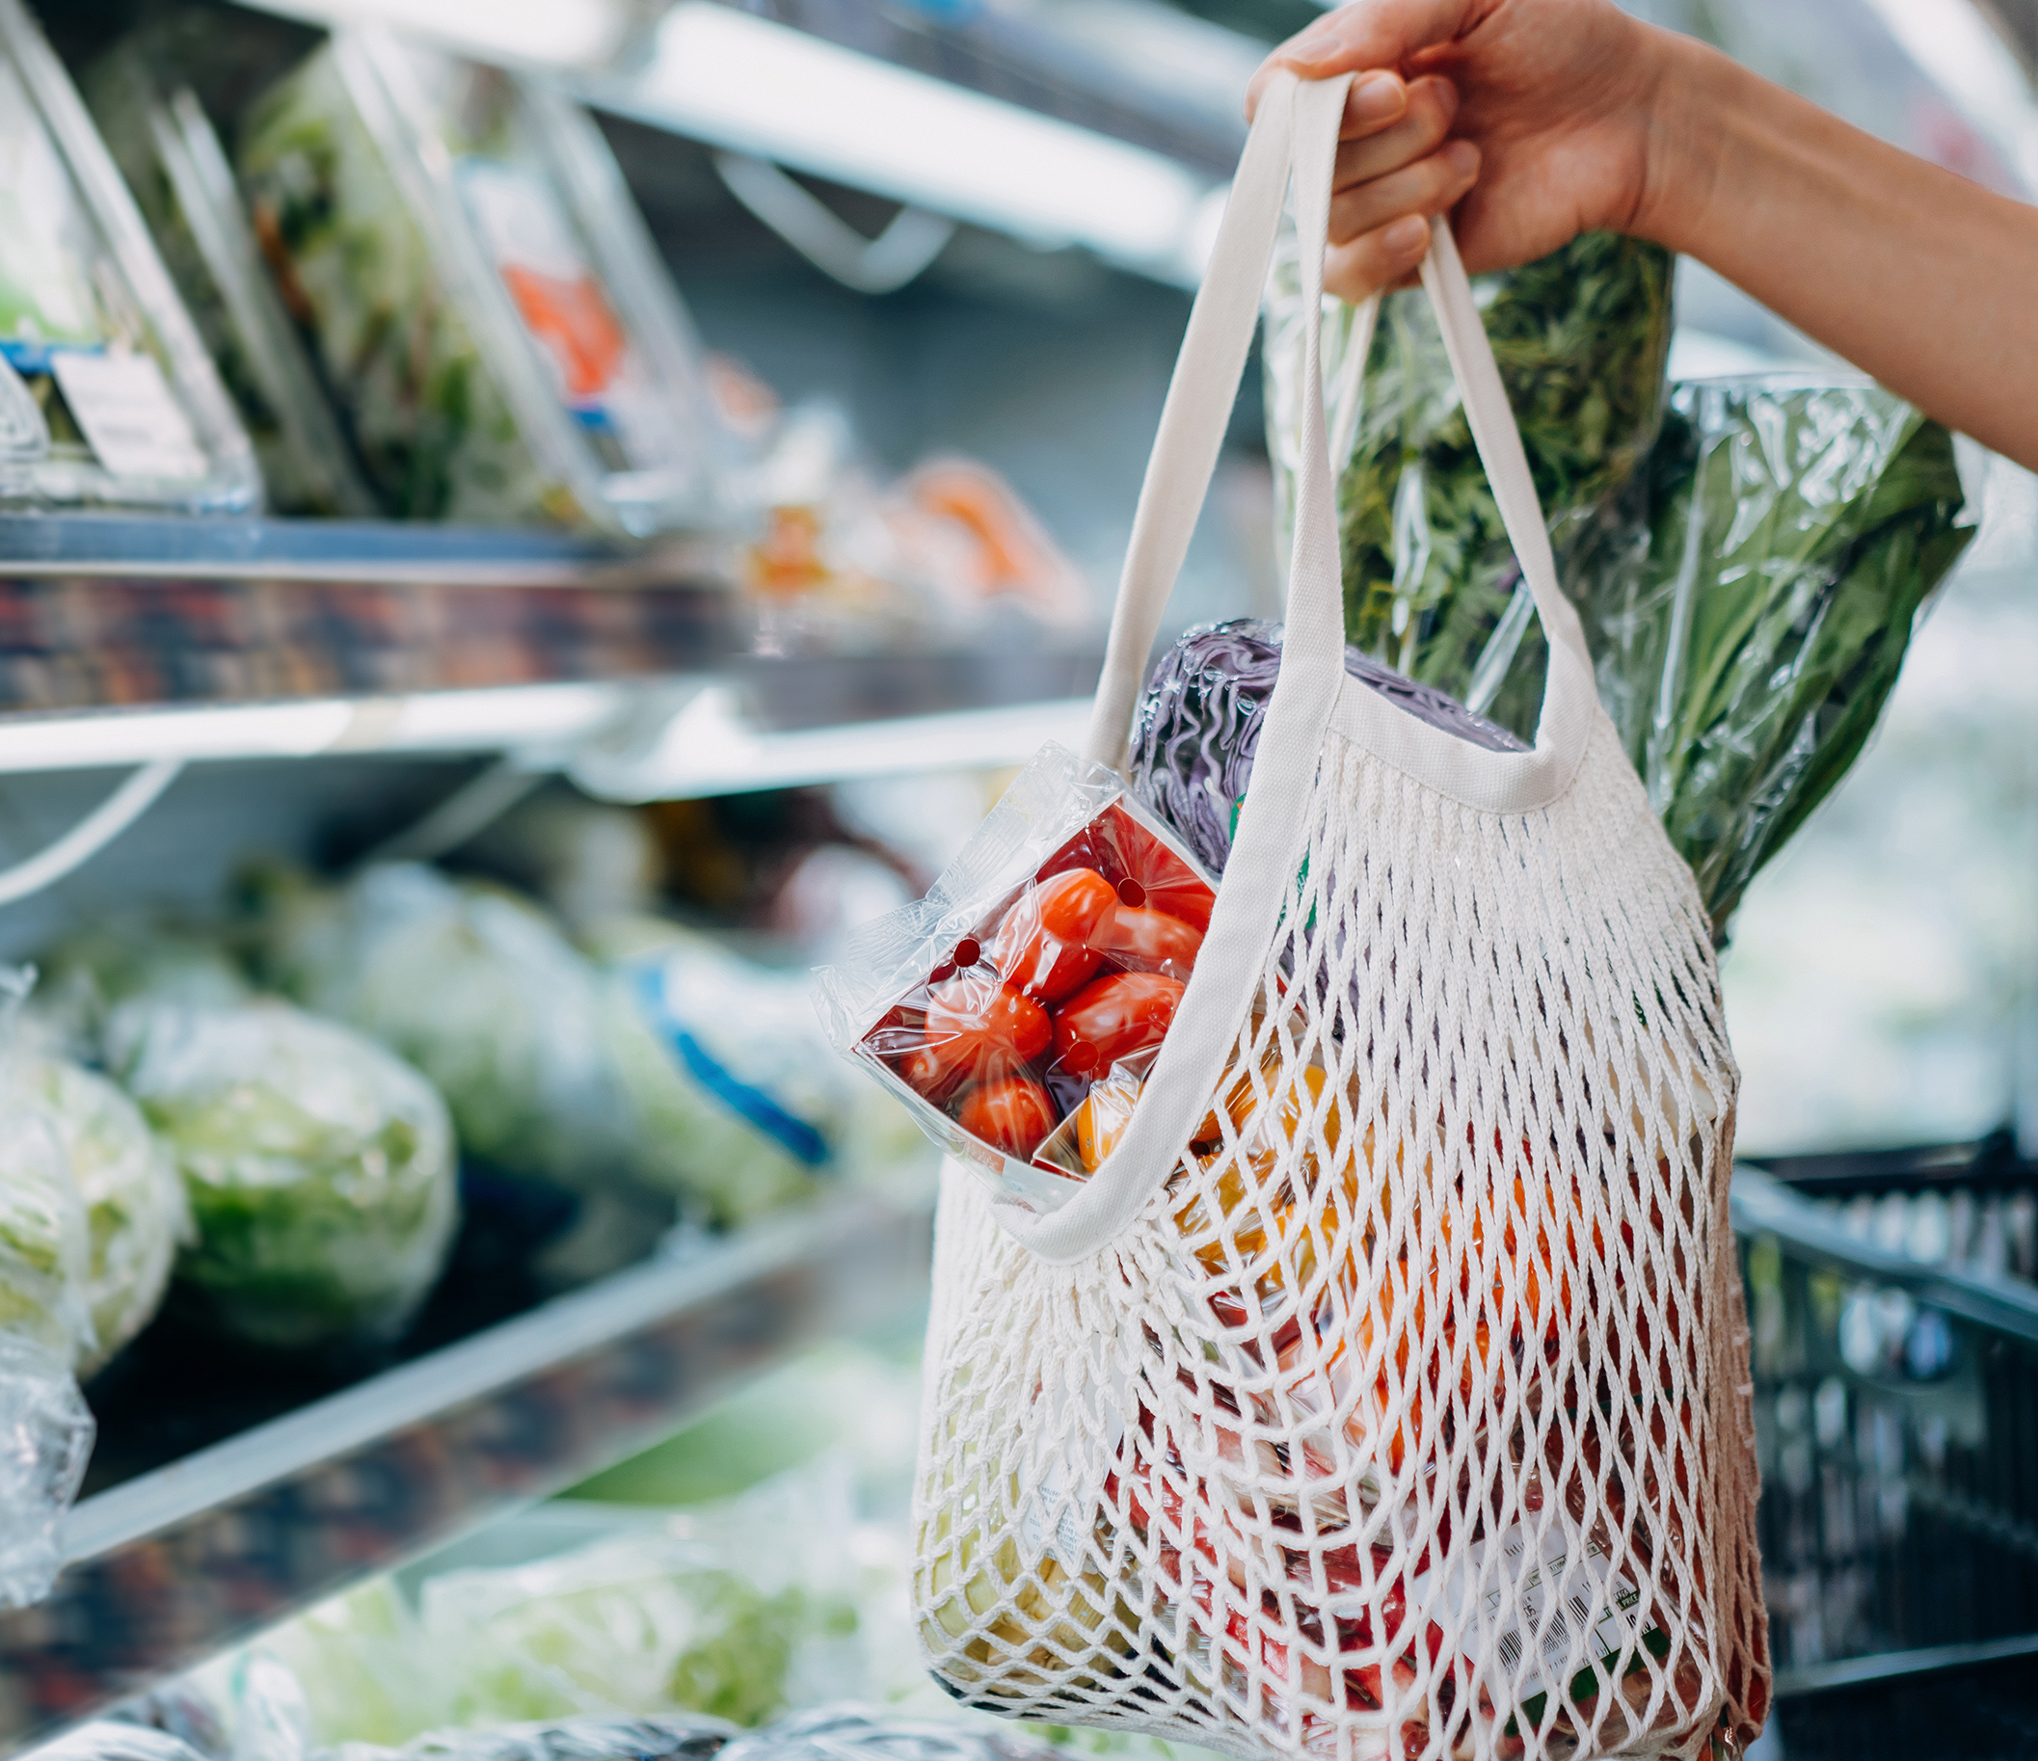
Organic Product Purchasing Predictions
Kaitlyn Vickers

Slide 2

Agenda
Business Problem
Overview of Exploratory Findings
Summary of Models
Organics Product Customer
Recommendations

Slide 3
The Business Problem
Can we analyze supermarket loyalty program data to identify customers likely to buy a new organic product line, understand their spending patterns, and develop effective marketing strategies?

Slide 4
Overview of Exploratory Findings
After cleaning and preprocessing data, we have 25149 entries to observe
There are almost twice as many Females as Males noted in the organics data set
The most highly represented class in this data is Silver
Platinum Members tend to spend more money than other classes
Those with an Affluence grade from 7 to 15 tend to spend more than other grades
Noted increase in spending as Age increases
There is a decrease in spending as time as a loyalty member increases

Slide 5
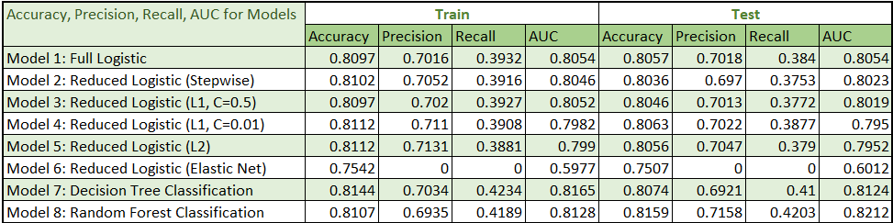
Summary of Models
A total of 8 models were created to predict organic product purchase…
The Classification Tree Models performed the best overall on the test data set
Notes:
Out of the 8 models created, the classification tree models (Model 7 and Model 8) performed the best
The recall rate all around is pretty low, which is problematic as the models are missing a significant portion of customers who are actually interested in purchasing organic products, leading to missed opportunities for sales
For the logistic models, each one has strengths and weaknesses, but I would have to choose the reduced logistic L1 as the best since each metric varies the least between the test and training for this model, and it still has a relatively high Accuracy and AUC
Note that the precision and recall rate for our Elastic Net Model is 0, this is because the model failed to correctly identify any true positives, indicating that it did not accurately predict any of the customers who would purchase organic products

Slide 6
About Model 7: Decision Tree
Important Factors: Age, Affluence Grade, Gender (M or F)
Model has a maximum depth of 6 nodes and 20 total final leaf nodes
Best recall rate so far, but has room for improvement

Slide 7
About Model 8: Random Forest
All factors are relevant for decision making
Uses 25 different decision tree models to create
Has best performance on the test statistics

Slide 8
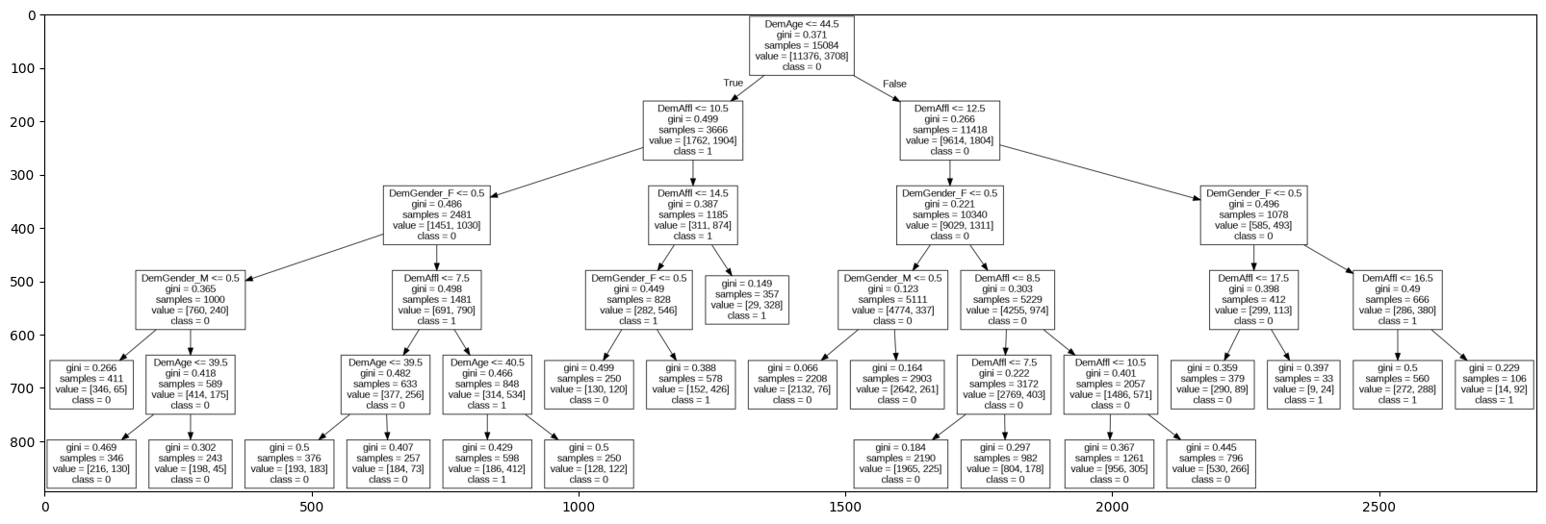
Organics Product Customer
Notes:
All of the highlighted nodes above are final leaves where the majority class is 1 or predicted to purchase the organic product

Slide 9
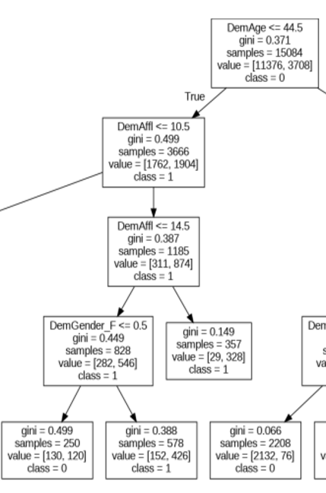
Organics Product Customer Profile
Example Customer Likely to Buy Organic Product:
Younger than 44.5 years old
Has an affluence grade between 11 and 14
Identifies as Female
Notes:
This is just one example from the six highlighted final nodes in the slide before

Slide 10
New Customer Predictions
Predictions made using Random Forest Model
Out of 150 customers, 32 were predicted to purchase the organic product
Notes:
Note that the decision tree model only classified 18 out of 150 as predicted to purchase the organic product

Slide 11
Recommendations
Keep growing current market
Market to Female Demographic
Target consumers with an affluence grade above 10
Cater to consumers 45 years old and older
Expand beyond current market
Create new marketing materials focused on the male and unknown gender demographics
Find ways to make products more affordable to those with lower affluence grades
Customize advertising for younger audiences
Notes:
There are many other strategies that could be mentioned here, but I chose to focus on the important factors in the Decision Tree model

